Slide 1

Welcome to
Priority One
Tax Academy
Tax Preparer Training
Amy Willingham
Managing Partner
Priority One Solutions LLC
October 8, 2026
Priority One Solutions LLC
01
Notes:
Suggested time: 1 minutes.
Welcome everyone. Confirm audio and that students have access to their software instructions. This session is designed for 48 minutes of presentation and demonstration, followed by questions.

Slide 2
Meet Amy Willingham
Managing Partner of Priority One Solutions LLC
13 years of tax preparation experience
Founded Priority One Solutions in April 2025
Your instructor and mentor throughout training
Priority One Solutions LLC
02
Notes:
Suggested time: 3 minutes.
Introduce yourself in your own words. Explain your experience and how students can ask for support. Add your personal reason for teaching if you wish. Do not imply a credential that has not been supplied. Source: Amy’s approved slide content.

Slide 3
Why We Do This Work
Help clients understand their tax situation
Prepare accurate returns and identify benefits they qualify for
Protect the personal information clients trust us with
Build preparer skills and confidence through mentorship
Priority One Solutions LLC
03
Notes:
Suggested time: 3 minutes.
Share why this work matters to you. Accuracy, eligibility and privacy take priority over promises of a refund. Ask students what motivated them to join. Source: approved company messaging.

Slide 4
Our Growth Plans
Expand remote services with a seasonal office in Midland
Serve clients in person and remotely
Reach new clients through advertising and referrals
Grow our team through training and mentorship
Work toward 2,000 completed returns in the 2027 season
Priority One Solutions LLC
04
Notes:
Suggested time: 3 minutes.
The office is planned, not secured. The 2,000-return figure is a growth target, not guaranteed volume. Distinguish this commission-based training team from proposed hourly storefront employees. Do not introduce lender financial projections into this lesson. Source: supplied Priority_One_Solutions_Business_Plan_65000(1).pdf and approved slide wording.

Slide 5
Grow Our Team and Earn a Referral Bonus
Invite friends, family, or others to join as tax preparers
Every preparer receives at least 60% of preparation fees
Earn 10% of your recruited preparer’s commission
Priority One pays the bonus from its own share
The bonus continues while both preparers remain on the team
Example: $500 fee → $300 preparer commission → $30 referral bonus
Priority One Solutions LLC
05
Notes:
Suggested time: 3 minutes.
Example approved by Amy: $500 preparation fee at a 60/40 split gives the preparer $300. The referring preparer receives $30, which is 10% of $300. Priority One retains $170 after paying the bonus. The recruited preparer’s commission is unchanged. This is a referral bonus on the preparer’s commission, not 10% of gross fees. Amy should explain administrative attribution and payout details without inventing terms. Source: Amy’s explicit instructions October 7, 2026.

Slide 6
What You Will Learn
Interview clients and gather the right documents
Recognize common tax forms
Enter information accurately in TaxSlayer Pro
Practice due diligence and document client answers
Review your work and know when to ask for help
Today: navigation and a fictional practice return
Priority One Solutions LLC
06
Notes:
Suggested time: 2 minutes.
Today’s focus is software navigation and beginning a fictional practice return. Detailed due diligence will have its own lesson. Source: Priority One Tax Academy (1).pdf, Module 1, and approved slide wording.

Slide 7
Due Diligence Begins With the Client Interview
Ask follow-up questions about missing or inconsistent information
Document client answers and supporting information
Bring unresolved questions to Amy before moving forward
Priority One Solutions LLC
07
Notes:
Suggested time: 4 minutes.
Explain that software entry is only part of preparation. Ask: What would you do if a client’s answers conflict with their documents? Expected response: pause, ask reasonable follow-up questions, document and escalate unresolved issues. A later lesson covers Form 8867, applicable benefits and recordkeeping. Source: IRS https://www.irs.gov/tax-professionals/eitc-central/due-diligence-requirements-for-knowledge-and-recordkeeping, reviewed October 7, 2026.

Slide 8
Protecting Client Information
Use your own software account and keep login details private
Collect documents through the approved secure upload process
Keep client documents out of personal messages and social media
Lock your screen when you step away
Report suspicious messages or disclosures to Amy immediately
Priority One Solutions LLC
08
Notes:
Suggested time: 3 minutes.
Company expectations: use fictional information during demonstrations. Do not display passwords, identification or live taxpayer data when screen sharing. These introductory practices do not replace the company’s full security procedures. Source: approved company policies and supplied meeting checklist.

Slide 9
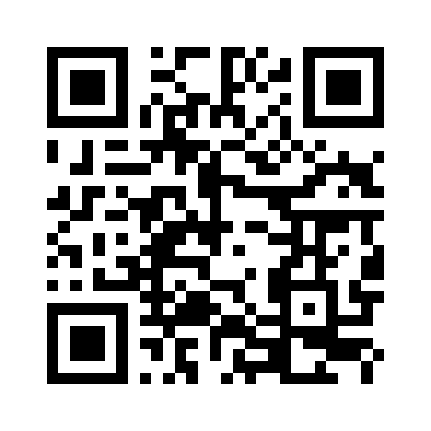
Secure Document Upload With TaxesToGo
Clients can provide information and upload tax documents
Send clients our company download link
Use the app for identification, W-2s and other documents
Client Document Upload
Scan to download TaxesToGo
and securely submit documents
Download TaxesToGo
Priority One Solutions LLC
09
Notes:
Suggested time: 3 minutes.
Explain client-facing use. Demonstrate with fictional information only. QR and hyperlink both target https://taxestogo.com/App/Download/78285. A download alone does not complete intake: verify the client connection and receipt of documents using the company’s configured workflow. Provider security information: https://www.taxestogo.com/privacy. App description: https://www.taxestogo.com/. Reviewed October 7, 2026.

Slide 10
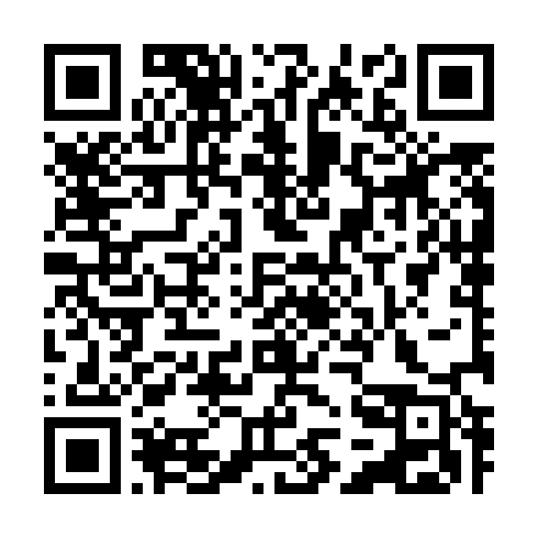
Getting Ready for TaxSlayer Pro
Check business email for software access instructions
Sign in using your individual account
Confirm access before practice begins
Contact Amy if you have trouble signing in
Use assigned fictional information during training
Staff Login
Scan to access TaxSlayer Pro
Use your individual credentials
Priority One TaxSlayer Pro Login
Priority One Solutions LLC
10
Notes:
Suggested time: 2 minutes.
Staff-only QR and hyperlink use Amy’s exact supplied company URL. The QR does not contain credentials or bypass authentication. Do not display passwords during demonstration. Before class, confirm with the CloudTaxOffice provider which training environment and test identifiers are supported. The supplied URL alone does not verify training functionality.

Slide 11
TaxSlayer Pro Navigation
Locate the return list
Open the assigned practice return
Find personal information and income sections
Save your work
Locate review messages
Priority One Solutions LLC
11
Notes:
Suggested time: 7 minutes.
Live demonstration. Use Amy’s confirmed practice environment and actual interface. These are navigation goals, not verified exact menu labels. Allow students to follow along. If training access is not ready, demonstrate a provider-approved environment and defer hands-on entry. No live transmission.

Slide 12
Guided Practice
Locate or open your own practice return
Enter the fictional taxpayer’s basic information
Find the W-2 entry section
Enter the sample W-2 details
Save your work and identify questions for review
Priority One Solutions LLC
12
Notes:
Suggested time: 10 minutes.
Use one fictional scenario with a separate practice return for each student. Do not let multiple students edit one shared return. Confirm provider-approved training identifiers and setup before class. TaxSlayer exercises and answer keys: https://www.taxslayerpro.com/education/practice-tax-returns. Match the software tax year to the exercise year. This deck does not supply a completed scenario or test identifiers. Do not submit to a live filing queue.

Slide 13
Before Our Next Class
Confirm your software login works
Finish the assigned practice activity
Write down questions or problems you encountered
Schedule your one-on-one call with Amy if needed
Priority One Solutions LLC
13
Notes:
Suggested time: 1 minutes.
Confirm what was actually assigned and how students can schedule calls. If the practice environment remains unavailable, assign login checks and questions only. Recap the key steps.

Slide 14
Questions and Discussion
What would you like to review?
Did you encounter any software access issues?
Which steps would you like to practice again?
amy@priorityonetaxsolutions.com
Priority One Solutions LLC
14
Notes:
Presentation and demonstration total 48 minutes. Use the remaining portion of the 7–8:30 PM Central session for questions and support. Contact Amy at amy@priorityonetaxsolutions.com.

